Slide 1
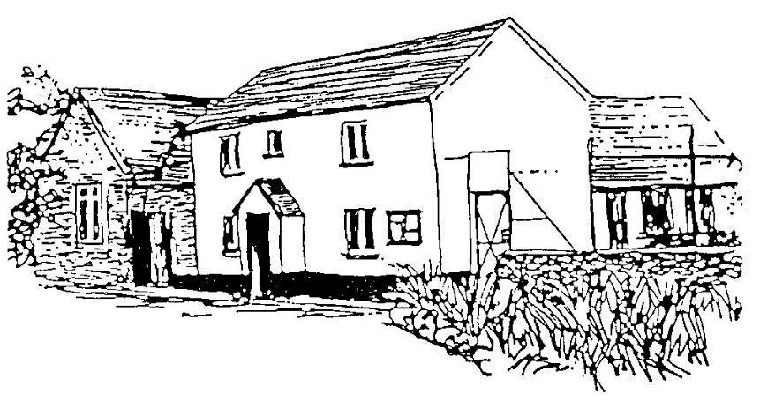

Horwood & Newton Tracey Primary school
Early Years Foundation Stage at our school 2022
Our EYFS provision has a nursery class (mornings only) and a Reception class.We work closely with the local private nursery, Lovacott Nursery, to offer wrap-around-care for families who need this
Our provision is located adjacent to the KS1 class, and offers a safe and stimulating environment, with access to an outdoor covered space, decking area and a small garden with a mud kitchen. Bringing the natural world inside inspires us to use natural resources as much as possible for play, and to create calm, comfortable spaces supporting emotional well being, encouraging children to confidently explore and create..

Slide 2
Our Intent, Implementation and Impact for Early Years Foundation Stage
INTENT - at Horwood and Newton Tracey Primary School (HNTPS), we celebrate our rural village setting in North Devon, which offers a strong sense of belonging and community to children and their families.
.Every child is recognised as a unique individual and we celebrate and welcome differences within our school community. The ability to learn is underpinned by the teaching of basic skills, knowledge, concepts and values. We provide enhancement opportunities to engage learning and believe that first experiences of school should be happy and positive, enabling us to develop a lifelong love of learning.
Community involvement is an essential part of our curriculum and activities such as visiting Bailey Wood for forest school, or Farmer Ford’s fields, enable the children to gain knowledge of the world around them, as well as weekly visits to the village hall or playing field for physical play and activities.
Throughout their time in EYFS, the children develop a sense of belonging to our school community, ready for transition to year 1 the following academic year. They have the confidence and skills to make decisions and self-evaluate, make connections and become lifelong learners.

Slide 3
We intend:
To work in partnership with parents and carers, recognising that this will enable children to develop trust and independence and to thrive in school reaching their full potential from their various starting points
To understand and follow children's interests and provide opportunities throughout our EYFS curriculum to support learning, consolidate and deepen knowledge and ensure children meet their next steps.
To create an indoor and outdoor environment which supports learning.
To prepare children to reach the Early Learning Goals at the end of the Foundation Stage and ensure children make at least good progress from their starting points.

Slide 4
Early Years - Our Intent
Our curriculum is underpinned by the statutory requirements of the EYFS with the Programmes For Learning in each area of development. It is also developed from an understanding of our children, their interests, knowledge and experiences, to ensure that we build upon these during their time with us. The children will learn new skills, acquire new knowledge and demonstrate understanding through the seven areas of the EYFS curriculum:
Personal, Social and Emotional Development
Physical Development
Communication and Language
Literacy
Mathematics
Understanding the World,
Expressive Arts and Design

Slide 5
Early years - IMPLEMENTATION
Throughout EYFS at HNTPS, we follow the Early Years Statutory Framework for the Early Years Foundation Stage, updated in 2023 by the DfE. This framework specifies the requirement for learning and development in the Early Years with Educational Programmes for prime and specific areas of learning that we must cover in our curriculum.
We have a curriculum that is child-centred and that is based upon direct experiences and topics which engage the children. We encourage active learning to ensure the children are motivated and interested. We take time to get to know children's interests and their likes to support learning. All areas of the EYFS curriculum are followed and planned for to ensure there is a broad, balanced and progressive learning environment and curriculum.
The children will learn new skills, acquire new knowledge and demonstrate understanding through the seven areas of the EYFS curriculum:
Personal, Social and Emotional Development
Physical Development
Communication and Language
Literacy
Mathematics
Understanding the World,
Expressive Arts and Design

Slide 6
Weekly planning:
These 7 areas are used to plan children's learning and activities. Planning for this curriculum is designed to be flexible so that a child's unique interests are supported. During each week, the children participate in phonics and reading sessions as well as adult led literacy and maths tasks with opportunities to select from a range of child initiated tasks through both the indoor and outdoor provision. A vital aspect in the development of essential knowledge and skills is the use of continuous provision. This allows children to use and develop taught skills throughout the year on a daily basis. Continuous provision practise and principles begin in EYFS and support children to develop key life skills such as independence, innovation, creativity, enquiry, analysis and problem solving. During the school day, children will have an opportunity to work independently, work collaboratively with their friends and with members of staff.
Daily guided activities : These are planned to cover different areas of the EYFS curriculum and allow children to develop their next steps in learning. Through observation and discussion, areas of need and next steps are identified for all children to ensure good progress is made. There are also a range of stimulating and engaging activities which the children can access independently and a variety of opportunities for child-initiated play. In planning and guiding children's activities we reflect on the different ways that children learn and reflect these in our practise. Staff in the EYFS make regular observations of the children's learning to ensure their next steps are met. We regularly assess where the children are, using 'Development Matters' and then ensure our planning, adult interaction and learning environment; including continuous provision, support children to reach their next steps. We will include interventions for groups or individuals if and when necessary.

Slide 7

Characteristics of Effective Teaching & Learning
Three characteristics of effective teaching and learning are:
• playing and exploring – children investigate and experience things, and ‘have a go’
• active learning – children concentrate and keep on trying if they encounter difficulties, and enjoy achievements
• creating and thinking critically – children have and develop their own ideas, make links between ideas, and develop

Slide 8
Characteristics of Effective Teaching & Learning
Strategies for doing things
Children in EYFS learn by playing and exploring, being active, and through creative and critical thinking which takes place both indoors and outside. Our outdoor areas are used all year round and in most weather conditions. We have a dedicated time focusing on health and self-care where we explore yoga and relaxation techniques. We share a range of healthy snacks and learn about the importance of a healthy balanced lifestyle to maintain our own wellbeing. All children participate in a Nativity, receive certificates in assembly, and participate in trips to the theatre, local library and a working farm. They enjoy visits to a local farmer and his animals including lambs. They are visited by a range of People Who Help Us, such community members including the police, fire service, postal workers, vets, doctors, nurses, their animals and vehicles. The children participate in whole class assemblies and Family Group weekly sessions. They plant bulbs and seeds, watch them grow and eat their produce such as strawberries.

Slide 9

Long term plan 21 - 22 | Autumn 1 | Autumn 2 | Spring 1 | Spring 2 | Summer 1 | Summer 2
General themes | All about Me! | Let’s celebrate! | Tell me a story | Where Am I ? | Growing away | Going Away
COET&L overArching Principles | Characteristics of Effective tTaching & Learning Playing and exploring - Children investigate and experience things, and ‘have a go’. Children who actively participate in their own play develop a larger store of information and experiences to draw on which positively supports their learning Active learning: - Children concentrate and keep on trying if they encounter difficulties. They are proud of their own achievements. For children to develop into self-regulating, lifelong learners they are required to take ownership, accept challenges and learn persistence. Creating and thinking critically: - Children develop their own ideas and make links between these ideas. They think flexibly and rationally, drawing on previous experiences which help them to solve problems and reach conclusions.
 | Unique Child: Every child is unique and has the potential to be resilient, capable, confident and self-assured. Positive Relationships: Children flourish with warm, strong & positive partnerships between all staff and parents/carers. This promotes independence across the EYFS curriculum. Children and practitioners are NOT alone – embrace each community. Enabling environments: Children learn and develop well in safe and secure environments where routines are established and where adults respond to their individual needs and passions and help them to build upon their learning over time. Learning and Development: Children develop and learn at different rates (not in different ways as it stated 2017). We must be aware of children who need greater support than others. PLAY: At HNTPS we understand that children learn best when they are absorbed, interested and active. We understand that active learning involves other children, adults, objects, ideas, stimuli and events that aim to engage and involve children for sustained periods. We believe that Early Years education should be as practical as possible and therefore , we are proud that our EYFS setting has an underlying ethos of ‘Learning through play’. PLAY is essential for children’s development across all areas. Play builds on children’s confidence as they learn to explore, to relate to others around them and develop relationships , set their own goals and solve problems. Children learn by leading their own play and by taking part in play which is guided by adults.’. We will ensure that all children learn and develop well and are kept healthy and safe at ALL times.
Reception Long term Plan 2021 -22

Slide 10
 | Autumn 1 | Autumn 2 | Spring 1 | Spring 2 | Summer 1 | Summer 2
General themes Possible themes/interests/ lines of enquiry | All about Me! photos Owl babies, Farmer Duck, Little red Hen, Rosie’s Walk, etc Autumn Harvest Family Growing up - generations | Let’s celebrate! Autumn Stick man Winter Arctic Lost and Found Snow bears/penguins Bonfire night Christmas/Father Christmas story Christ | Tell me a story Chinese New Year Cinderella, 3 little pigs, Goldilocks, Little Red Riding Hood, Jack and the Beanstalk, Gingerbread man, etc | Where do I Live? PEOPLE WHO HELP US AND WHERE WE LIVE Pancake day Easter Lent Police, firefighters, nurses and doctors, teachers, ambulance, etc Planting, gardening, Spring | Growing away Life cycles – frogs, butterflies, plants, etc Local area Planting and gardening | Going Away? Summer holidays (past and present) Hot places Rockpools Mermaids Superheroes Vehicles (past and present)
High Quaity texts |  | May include: Guy Fawkes: Recount Little Red Hen (x2 weeks) Talk for Writing Funnybones: Labelling Stick Man: Recount: Writing letters The Christmas Story Christmas Week Plus other texts from our brilliant books list | TRADITIONAL TALES Chinese New Year Cinderella, 3 little pigs, Goldilocks, Little Red Riding Hood, Jack and the Beanstalk, Gingerbread man, etc |  | May include: Oi Frog The Tadpoles Promise The Billy Goats Gruff (x2 weeks) Talk for Writing What the Ladybird Heard Rosie’s Walk Plus other texts from our brilliant books list
Enrichment | Wlak to farmer Frod Walk in village Visit to Rsoemoor | Story teller - steve manning, halloween, firework night, diwali, rmembranxcwe day, hanukkah, Nativity play Christmas party, Theatre visit | Chinese new year Valentines day | Story teller - Steve manning Visit to farmer Frod Visit to Barnstoale library Walk in village Visit from nurse, fire fighter, Mothers day cafe
Reception long term planning 2021-22

Slide 11
BAME main characters | Cultural diversity | Neurodiversity | physical disabilities | Different families
So much Shine Astro Girl Lulu’s first day Baby goes to market Mommy saying Full, full full of love 15 things not to do with a puppy Jabari jump s Izzy gizmo Little people big dreams books | The big book of families Maisie’s scrapbook Hats of faith The jasmine sneeze Golden domes and silver lanterns | We’re all wonders Perfectly norman Incredible you I see things differently Mr Gorski I think I have the wiggle Fidgets Because What makes me a me? The unbudgable curmudgeon | Its ok to be different When Charlie met emma Only one you Don’t call me special Happy to be me Millie gets her super ears | my pirate mums My two grandads We are family More people to love me Our class is a family Love makes a family Heather has two mummies
Diversity Texts to be read throughout the year during story time sessions

Slide 12
Early Years - Impact
It is our aim:
To provide an accessible EYFS curriculum that is inspiring, exciting and engaging for all.
To provide an appropriate balance between play and adult led activities.
To collaborate with parents/carers and build strong and develop strong relationships so parents can play an active role in their child’s learning.
To use assessment to help children extend their thinking and embed their learning providing appropriate next steps.

Slide 13

Early Years - Impact
See our separate end of year Nursery and Reception expectations.

